Slide 1
BharatVote: A Blockchain-Based Secure Voting System
Secure Voting, Stronger India
Archee Arjun • Shivangi Priya • Mohd Sultan • Keshav Gupta
Under the guidance of Professor Pravin Pawar
BharatVote

Slide 2
Agenda
1 | Introduction | 🧭
2 | Deliverables & Study Outputs | 📄
3 | Existing Solutions | 🔍
4 | Core Features | ⚙️
5 | Methodology & Stack | 🛠️
6 | Architecture | 🏗️
7 | Roadmap & Team Roles | 🗺️ 👥
BharatVote

Slide 3
Introduction
🔒 What is BharatVote?
BharatVote is a secure, remote voting prototype designed for web and mobile platforms. It uses blockchain and commit–reveal cryptography to ensure tamper-proof, verifiable, and privacy-preserving elections.
🗂️ Scope of the Study Project (3 Months)
This presentation summarizes the outcomes of our study-focused work, which included:
Phase 1 – Proposal: Core idea, motivation, and project goals
Phase 2 – SRS: Functional and non-functional requirements
Phase 3 – Technical Design: Architecture, UI mock-ups, workflows, and test plan
🎯 Goal: Build a well-defined design plan to guide the actual implementation next semester.
👥 Who is BharatVote For?
Voters – Participants in campus, housing, or local municipal elections
Election Administrators – Organizers managing small, community-based elections
Auditors – Reviewers ensuring fairness in trusted, small-scale setups
BharatVote

Slide 4
Problem statement
🎯 The Problem with Current Voting Systems
Institutions still rely on hardware-heavy, non-verifiable, and physically restrictive voting systems like EVMs + VVPATs — which aren’t built for remote or academic use.
🔍 Key Pain Points:
Opaque voting, insider tampering risks, no remote access, and hardware too costly for campuses.
✅ Our Aim
To design a simple, auditable, remote-friendly voting prototype
that solves these issues using blockchain and cryptography,
without relying on expensive equipment.
BharatVote

Slide 5
Deliverables
✅ Study Project Submissions (This Semester)
Phase 1: Project Proposal
Phase 2: SRS (Requirements Spec)
Phase 3: Technical Design Document
Supporting assets: UML diagrams, OpenAPI spec, UI mock-ups
This presentation
🔧 Foundation for Next Semester (Prototype Phase)
Smart contracts (Solidity, Sepolia)
Backend services (mock KYC, OTP, Merkle proof)
Web & mobile apps (React stack)
BharatVote

Slide 6
Usefulness
🌟 Why BharatVote Is Built for Small-Scale Elections
India hosts thousands of small and mid-scale elections — campus councils, union elections, professional body polls — often run manually by a handful of officials under immense pressure.
BharatVote replaces manpower-intensive voting with cryptographic trust.
🚀 What It Solves:
✅ Fewer boots, more trust – No need for dozens of officials; one admin controls the process digitally
✅ No paper, no queues – Voters cast their ballot from any device, in minutes
✅ No confusion, no disputes – Blockchain-backed receipts & audit trails eliminate tally errors and bias
✅ No booths, no barriers – Works for remote students, interns, exchange programs, NRIs
🏛️ Where It Fits:
Campus elections (BITS, IITs, NITs)
Student unions, alumni bodies, research councils
Professional or institutional elections where scale is moderate but credibility is critical
BharatVote brings auditability, ease, and inclusion — without needing EVMs, polling stations, or an army of staff.
BharatVote

Slide 7
Review of existing product
EVM + VVPAT (India’s National Standard)
🔧 How it works
Press button → vote stored in standalone hardware
Paper slip (VVPAT) flashes for 3 s and drops into sealed box
📍 Where used
2+ million machines in every Lok Sabha & Assembly election since 2019
⚠️ Key gaps
Only ~1.5 % slips hand-audited → limited statistical confidence
Firmware closed-source → insider chip re-flash risk
No remote voting; logistics of moving machines across 543 constituencies
💡 Lesson for BharatVote
Make the audit path public & end-to-end (blockchain events)
Design for remote, device-agnostic access to cut logistics
BharatVote

Slide 8
Review of existing product
Remote Voting Machine (RVM) Demo 2023
🔧 How it works
• One RVM can map up to 72 constituencies via dynamic ballot screen
• Voter verifies identity at booth, then selects home constituency
📍 Where used
• Prototype demo by ECI and IIT-Madras; not yet rolled out
⚠️ Key gaps
• Still requires physical booth travel for migrants
• Complex configuration; needs new staff training
• No robust biometric / wallet authentication
💡 Lesson for BharatVote
→ Remove hardware dependency: use browser + MetaMask
→ Keep admin UI minimal so existing staff need no retraining
BharatVote

Slide 9
Review of existing product
IIT-M × ECI × CDAC Blockchain Kiosk (2020 Pilot)
🔧 How it works
Special kiosk with fingerprint + webcam → writes vote to private chain
Commit-reveal not used; vote stored directly
📍 Where used
Limited on-campus dry-run at IIT-Madras; lab environment
⚠️ Key gaps
• Booth-bound; compromised kiosk = compromised vote
• Private blockchain → public can’t audit; code not released
• Extra biometric hardware raises cost
💡 Lesson for BharatVote
→ Public testnet (Sepolia) for open auditability
→ Use commit-reveal so even a tampered client can’t leak the vote
→ Leverage existing webcams/phones, not custom biometrics
BharatVote

Slide 10
Review of existing product
Telangana Smartphone Voting Pilot 2021
🔧 How it works
• Android-only “TSEC-eVote” app
• 3-factor auth: Aadhaar name match, selfie liveness, EPIC face match
• Votes stored on permissioned blockchain backend
📍 Where used
• Khammam municipal elections (dry run, Oct 2021)
⚠️ Key gaps
• Low turnout; many users failed KYC on 2G/3G networks
• Closed code + private ledger drew transparency criticism
• Device lock-in: lose phone = lose vote
💡 Lesson for BharatVote
→ Browser first with optional RN app = zero install barrier
→ Public, open-source contracts to build trust
→ Wallet-based identity allows switching devices seamlessly
BharatVote

Slide 11
Review of existing product
Helios (Open-Source Academic System)
🔧 How it works
• Web-based bulletin board; homomorphic tally; public audit of ciphertexts
• Used in universities & labour-union elections worldwide
📍 Where used
• 2008-present: Princeton grad council, Belgian student unions, etc.
⚠️ Key gaps
• Browser malware can leak your vote before encryption
• User must actively download proof and self-audit → low adoption
• No built-in voter eligibility check (trusts email lists)
💡 Lesson for BharatVote
→ Commit-reveal hides vote even on compromised device
→ Auto-generate simple Tx-hash receipt instead of manual proofs
→ Add Merkle whitelist to enforce eligibility on-chain
BharatVote

Slide 12
Important features of the product
✅ Feature | Why It Matters to Users
Commit–Reveal Privacy | Ballot stays secret until polls close → no early-trend manipulation
Merkle-Proof Voter Eligibility | Only authorised wallets can vote → blocks double / fake ballots
Device-Agnostic Remote Access | Browser + MetaMask or mobile app → vote anywhere, no special hardware
Real-Time Admin Dashboard | One-click phase switch & live tally charts → zero manual counting errors
Immutable On-Chain Audit Trail | Tx-hash receipt for every voter → 100% publicly verifiable results
BharatVote
August 4, 2025
12 / 19
Title of the project/product

Slide 13
Methodology
Our Build Stack
Our 5-Step Workflow
🖋️ Docs → Google Docs, Figma (key screens)
⚙️ Backend → Node.js + Express (mock KYC/OTP)
⛓️ Smart Contracts → Solidity on Hardhat, Sepolia fallback
🌐 Web → React + Vite (MetaMask)
📱 Mobile → React Native (WalletConnect)
🛠️ Testing → Hardhat test, Slither, manual click-through
1️⃣ Phase 1 — Brainstorm → Proposal draft → Mentor sign-off
2️⃣ Phase 2 — Interviews → SRS → Peer proof-read
3️⃣ Phase 3 — Architecture + ERD + UI → Build prototype on dev laptop
4️⃣ Weekly sync — 30 min Google Meet with mentor; feedback logged in shared sheet
5️⃣ Prototype demo — Localhost + Android emulator; Sepolia as public-chain fallback
BharatVote

Slide 14
Uses of Software
🛠️ Tool | What We Use It For
VS Code + GitHub | Coding + version control (all repos)
Hardhat + Sepolia faucet | Compile / deploy / test Solidity contracts
Node.js 18 + Express | Mock KYC + OTP REST API
React 18 (Vite) | Web SPA — admin dash & voter portal
React Native + Expo | Mobile voter flow on Android / iOS
MetaMask / WalletConnect | Sign commit / reveal txns
BharatVote

Slide 15
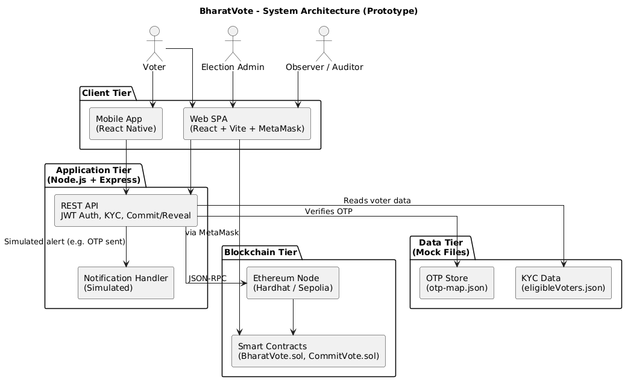
System Architecture
BharatVote

Slide 16
Budget
Budget Snapshot
💸 Total Development Cost: ₹0
Our prototype is built entirely using free, student-accessible tools:
Resource | Tool/Service | Cost
Smart Contract Dev | Hardhat, Sepolia Testnet | ₹0 (free test ETH)
Web & Mobile UI | React, React Native, Expo Go | ₹0
Backend API | Node.js + Express (local) | ₹0
Hosting (demo) | Netlify, Render (free tier) | ₹0
Face Matching | TensorFlow.js (local, mock) | ₹0
Documentation | Google Docs, Figma (edu plan) | ₹0
🛠 Goal: Validate design feasibility without paid infrastructure.
📌 For campus-scale pilot, only cloud credits or SMS API may need minimal funding.
BharatVote

Slide 17
How do you plan to implement the project?
Component | Technology | Key Features
Smart Contracts | Solidity + Hardhat | Commit-reveal voting, Admin controls, Merkle tree verification
Backend API | Node.js + Express | KYC verification, Voter eligibility, Merkle proof generation
Web Frontend | React TypeScript | MetaMask integration, Responsive UI, Admin panel
Mobile App | React Native | Cross-platform, MetaMask deep links, Touch-optimized
Implementation Phases
Phase 1 - Smart Contract Development & Backend API
Phase 2 - Web & Mobile User Interfaces
Phase 3 - Integration & Security Hardening
Phase 4 - Testing & Deployment
Expected Timeline: 10 weeks | Target: 99.9% uptime, <3s transactions
BharatVote

Slide 18
Responsibilities
Team Member | Role | Responsibilities
Archee Arjun | Blockchain | Smart contracts, Hardhat, Team coordination
Shivangi Priya | Frontend | React web app, MetaMask integration, UI/UX
Mod Sultan | Backend | Node.js API, KYC services, Database, Security
Keshav Gupta | Mobile | React Native app, Testing, Quality assurance
BharatVote

Slide 19
Conclusion
BharatVote aims to transform how small-scale elections are conducted by addressing key challenges like lack of transparency, fraud risk, limited accessibility, and paper-based inefficiencies. Using blockchain for tamper-proof records, commit–reveal cryptography for privacy, and Merkle proofs for voter validation, it ensures secure, verifiable voting. Its web and mobile interfaces with MetaMask integration make voting accessible to all, including remote and disabled users. With real-time tallying, open-source smart contracts, and a user-friendly admin dashboard, BharatVote delivers trust, transparency, and ease — a prototype built to restore faith in democratic participation and pave the way for scalable, cost-effective digital elections.
BharatVote

